Slide 1

Customer purchase behavior in retail using data analytics
Shabeeb Althaf M B- MBT8

Slide 2
Project Overview
This is a Capstone Project to learn data analysis and graphical display utilizing Excel, SQL and Power BI in a retail and e-commerce dataset.
Objectives:
Proficiency in Excel:
Ability to clean and pre-process data using Excel's functions and tools.
Competence in performing statistical analysis, creating pivot tables, and visualizing data through charts and graphs.
SQL Query Skills:
Proficiency in writing and executing SQL queries to retrieve, manipulate, and aggregate data.
Understanding of joins, subqueries, and aggregate functions to extract meaningful insights from relational databases.
Power BI Expertise:
Capability to import and integrate data from multiple sources into Power BI.
Skill in building interactive dashboards and reports that effectively communicate insights using various visualizations and customizations.
Data Analysis Proficiency:
Competence in analysing data trends, patterns, and anomalies to derive actionable insights.
Ability to create calculated columns, measures, and KPIs using DAX to perform advanced data calculations.
Business Applications:
Application of data analytics skills to real-world business scenarios such as sales performance analysis, customer segmentation, and inventory management.
Presentation of findings and recommendations to support strategic decision-making and business growth.
Hands-on Project Experience:
Practical experience in handling a comprehensive data analytics project from data preparation to visualization and analysis.
Confidence in using Excel, SQL, and Power BI tools independently for future data-related projects and tasks.

Slide 3
Data Pre-Processing
Data pre-processing using Excel refers to the process of preparing raw data for analysis by cleaning, transforming, and organizing it. It ensures that the data is in the correct format, free from errors or inconsistencies, and ready for use in analysis or modelling. This step is crucial for improving data quality and ensuring accurate results in any analysis.
Data Cleaning:
Handling Missing Data: Replace or remove empty cells (missing values). You can fill them with averages, medians, or forward/backward fill (using nearby values).
Removing Duplicates & Correcting Errors : Identify and remove duplicate rows or entries to avoid redundant data. Fix inconsistencies like spelling mistakes, incorrect formats, or outliers.
Data Transformation:
Data Formatting: Ensure consistent data formats, such as dates, numbers, and text.
Text to Columns: Split data from a single column into multiple columns (e.g., separating full names into first and last names).
Concatenation: Combine data from multiple columns into one (e.g., merging first and last names into a full name).
Data Normalization/Standardization: Adjust values to bring them to a common scale (e.g., converting percentages to decimals).
Filtering and Sorting:
Filtering: Use filters to focus on specific subsets of data based on criteria (e.g., filtering data by date, region, or value range).
Sorting: Sort the data in ascending or descending order based on a specific column.
Handling Outliers:
Identifying Outliers: Use conditional formatting or statistical techniques (mean, standard deviation) to identify data points that deviate significantly from others.
Managing Outliers: Remove or cap extreme outliers if they may distort analysis results.
Data Validation:
Set up validation rules to ensure that future data entry meets specific criteria (e.g., only dates or numbers within a range).
Pivot Tables and Aggregation:
Use pivot tables to summarize and aggregate data (e.g., summing up sales by region or product type).
Formula Application:
Apply Excel formulas such as IF, VLOOKUP, INDEX-MATCH, or SUMIF to automate data calculations or transformations.

Slide 4
Data Transformation
Before
After

Slide 5
Basic Summary Statistics:
Question 1: Calculate the summary statistics (mean, median, mode & standard deviation) for the list price of the products.
Question 2: Create a pivot table to summarize total sales (quantity * list price) by store and by product category.

Slide 6
Question 3: Highlight the top 10 products based on total sales.
Question 4: Identify and correct any inconsistencies or missing data in the customers table.
Solution: All the NULL values have been assigned a common phone number in order to avoid NULL values in the dataset and customer name has been merged.

Slide 7
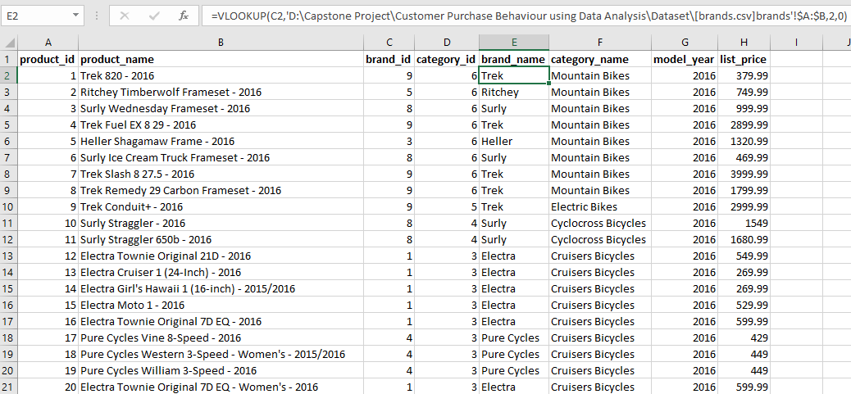
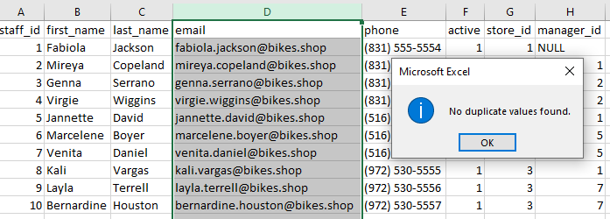
Question 5: Use VLOOKUP to match products names with their respective categories and brands
Question 6: Data validation to ensure all email address in the staffs table are unique and correctly formatted.

Slide 8
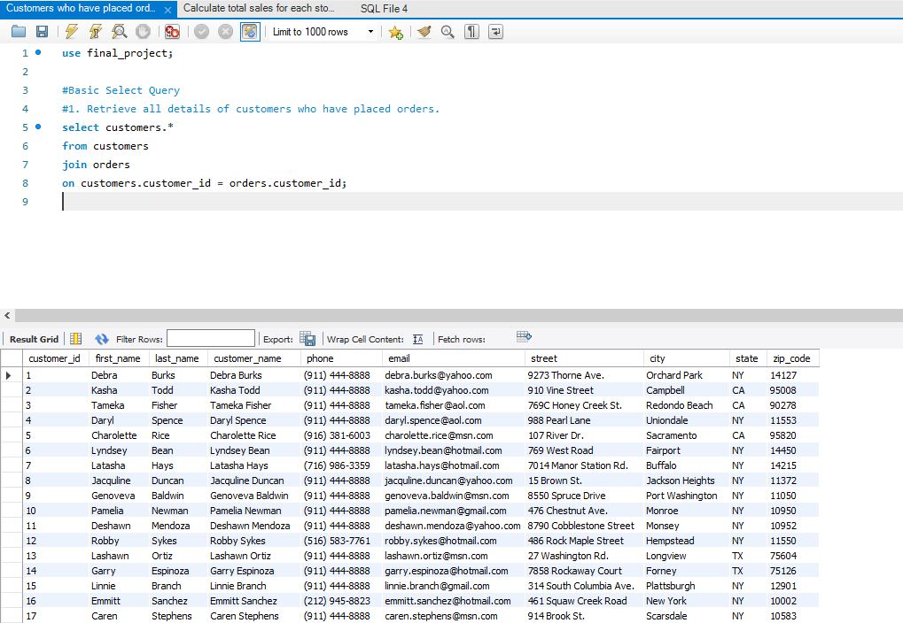
Basic Select Query:
Question 1: Retrieve all details of customers who have placed orders.
Task: Write a SQL query to join the customers and orders tables and select relevant customer details.

Slide 9
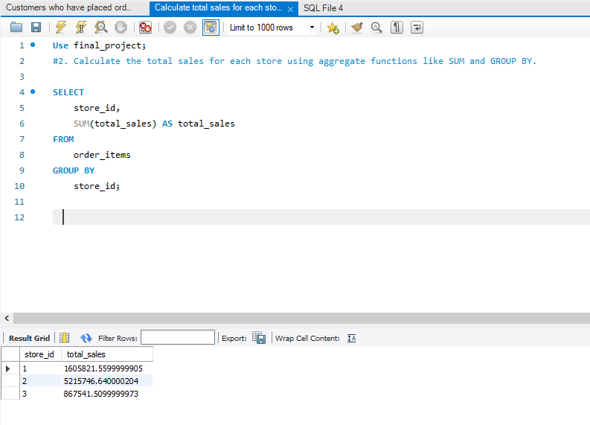
Aggregate Functions:
Question 2: Calculate the total sales for each store.
Task: Use aggregate functions like SUM and GROUP BY to calculate total sales from the orders and order_items tables.

Slide 10
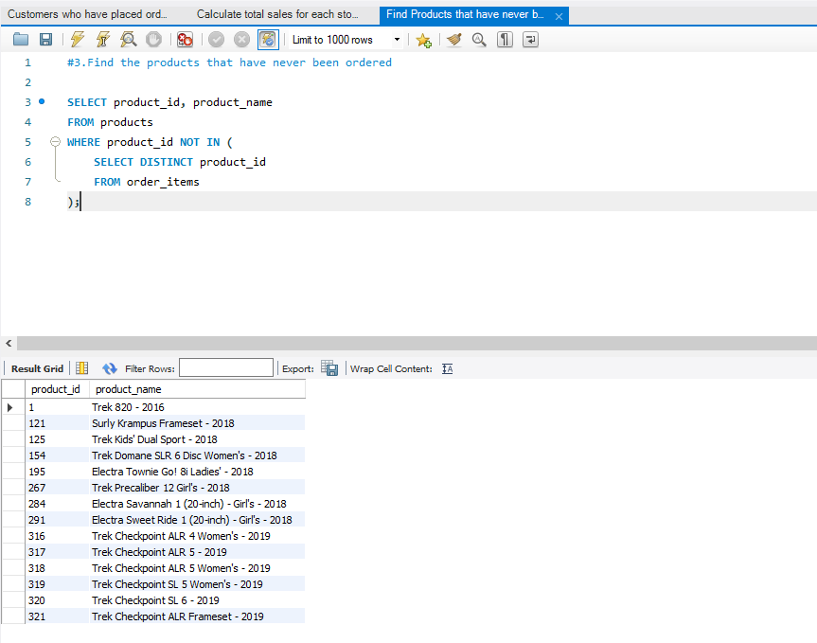
Subqueries:
Question 3: Find the products that have never been ordered.
Task: Write a subquery to identify products in the products table that do not appear in the order_items table.
The subquery SELECT product_id FROM order_items fetches all product_ids that appear in the order_items table (i.e., products that have been ordered).
The outer query selects products from the products table where the product_id is not present in the list of ordered product IDs from the subquery. Thus, it returns products that have never been ordered.

Slide 11
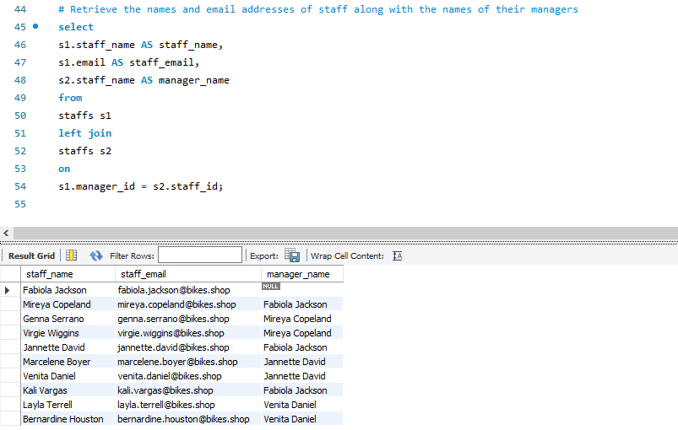
Joins:
Question 4: Retrieve the names and email addresses of staff along with the names of their managers.
Task: Write a SQL query to join the staffs table with itself to get staff and their manager information.

Slide 12
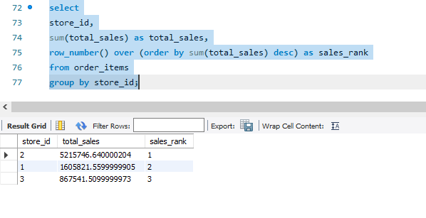
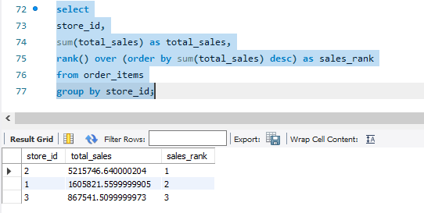
Window Functions:
Question 5: Rank stores based on their total sales.
Task: Use window functions like ROW_NUMBER() or RANK() to rank stores based on total sales.

Slide 13
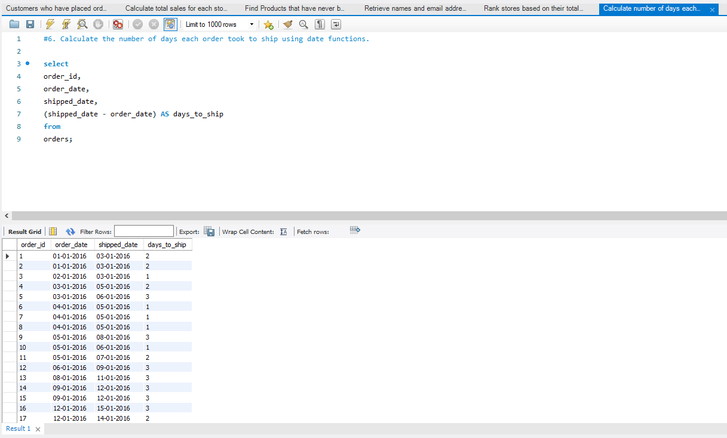
Date Functions:
Question 6: Calculate the number of days each order took to ship.
Task: Use date functions to calculate the difference between shipped_date and order_date in the orders table.

Slide 14
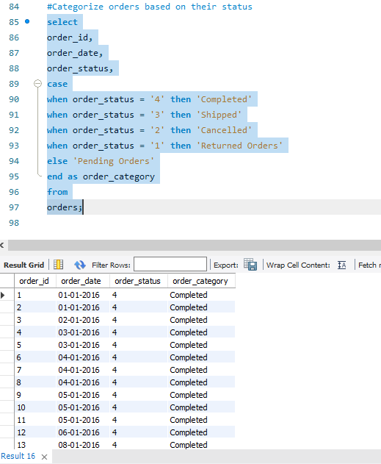
Case Statements:
Question 7: Categorize orders based on their status.
Task: Use CASE statements to categorize orders in the orders table into different status groups.

Slide 15
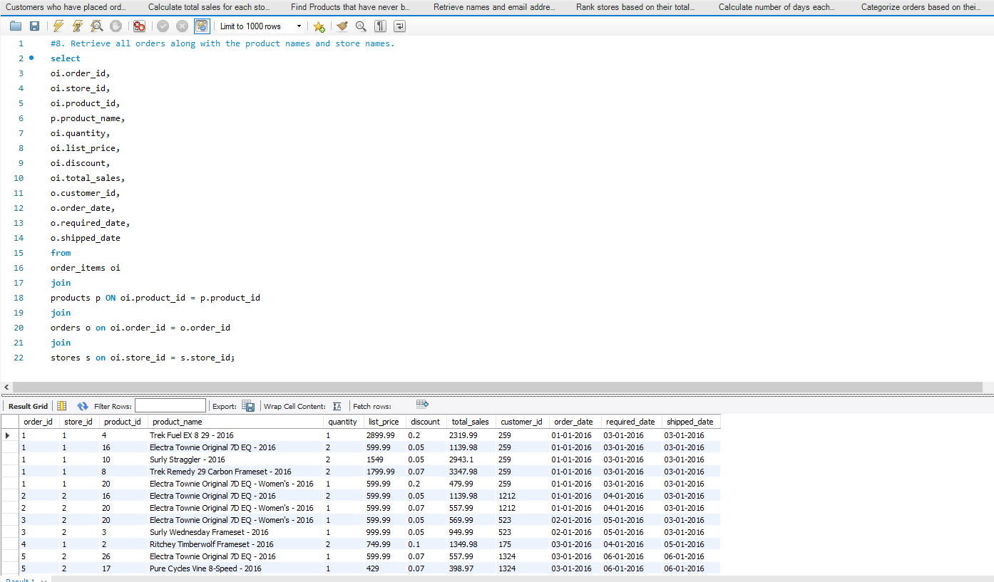
Complex Joins:
Question 8: Retrieve all orders along with the product names and the store names.
Task: Write a SQL query to join the orders, order_items, products, and stores tables.

Slide 16
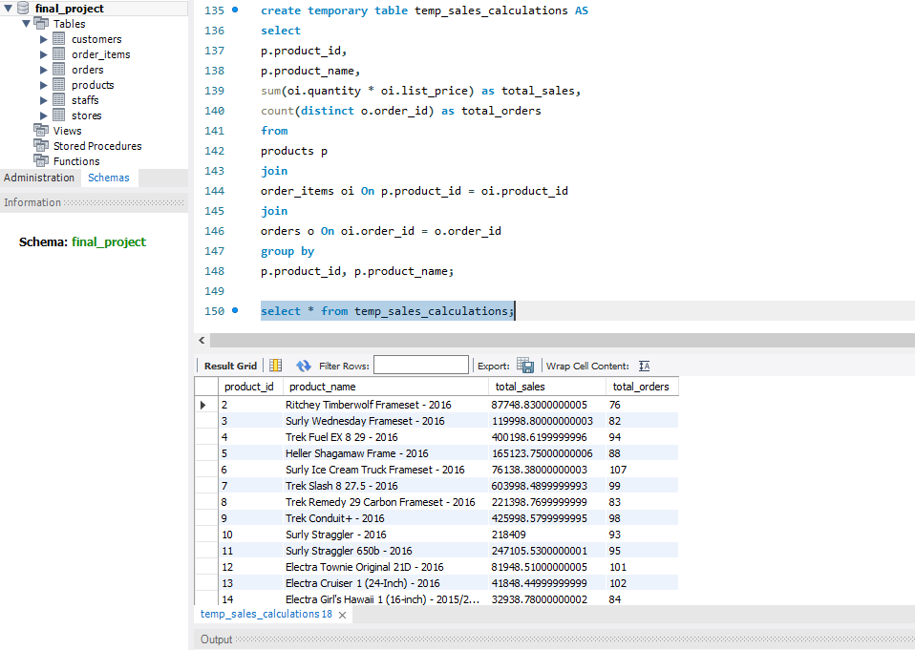
Temporary Tables:
Question 9: Create a temporary table to store intermediate sales calculations.
Task: Use CREATE TEMPORARY TABLE to store results of a complex calculation for further analysis.

Slide 17
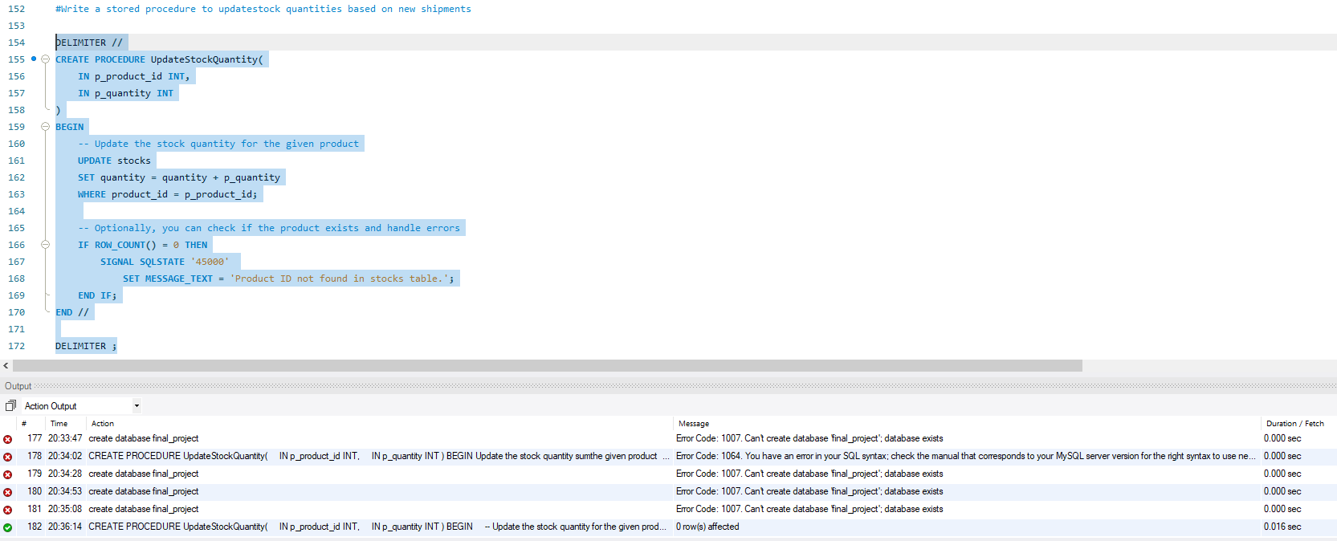
Stored Procedures:
Question 10: Write a stored procedure to update stock quantities based on new shipments.
Task: Create a stored procedure that updates the stocks table based on incoming shipment data.

